Slide 1


Slide 2
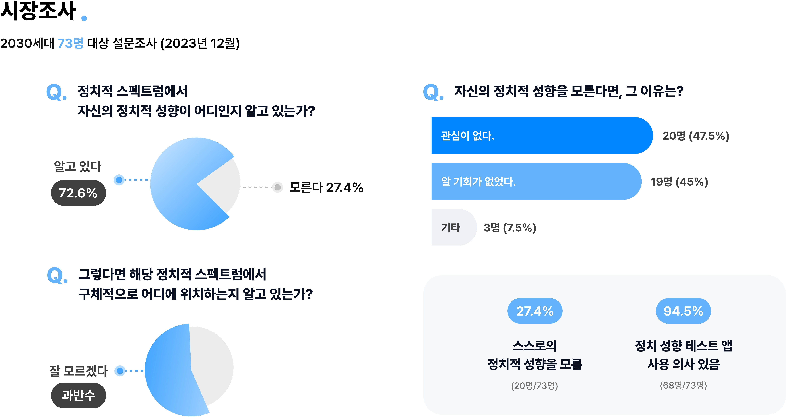

Slide 3


Slide 4
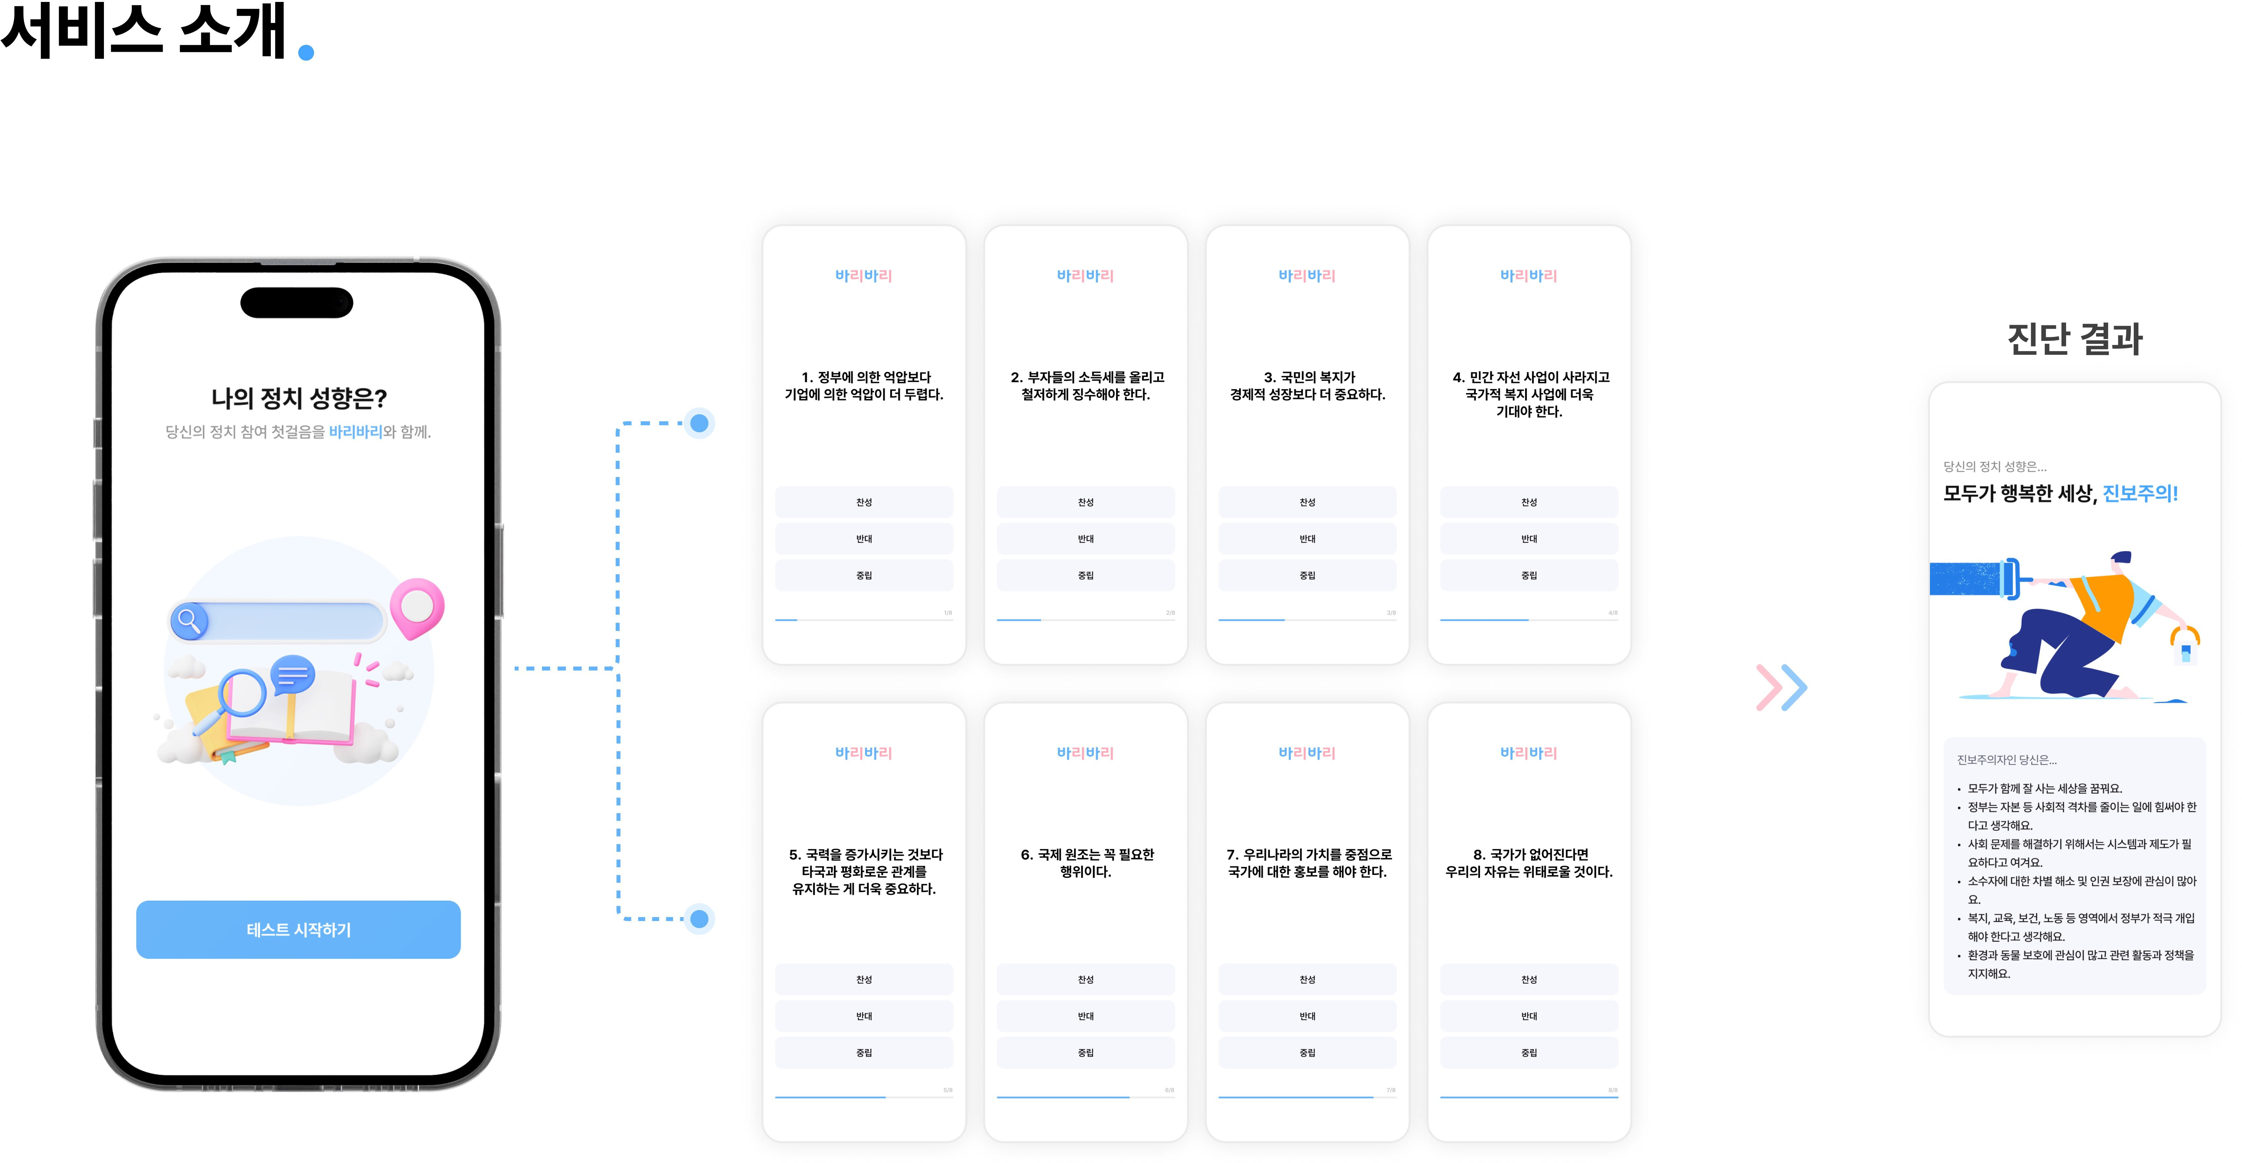

Slide 5
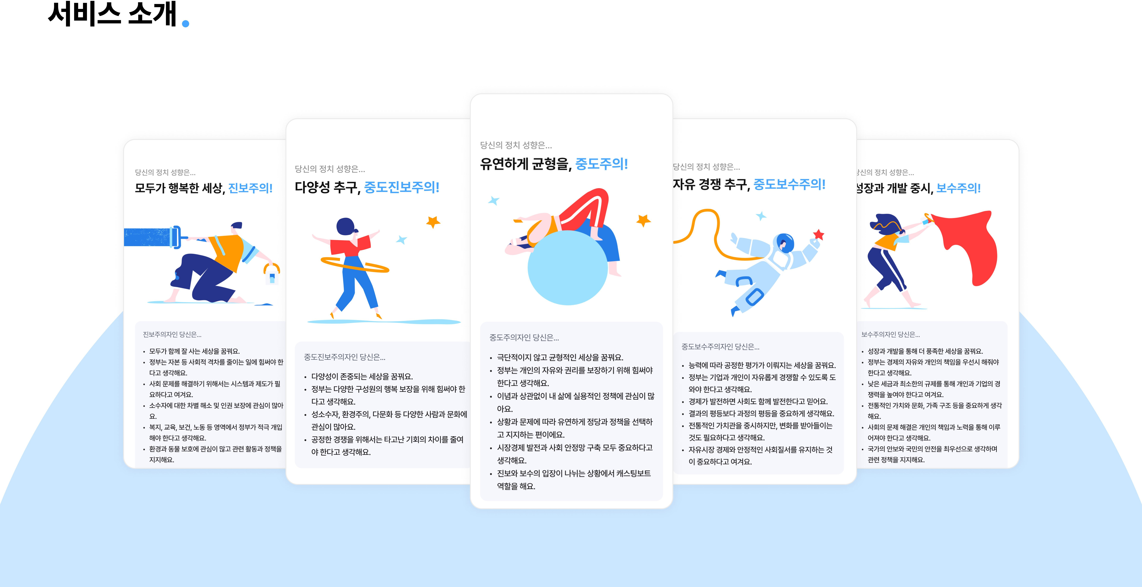

Slide 6


Slide 7

https://github.com/KimYerim1214/PoliticalTest4
https://www.youtube.com/watch?v=EYvrSLKhx90

